Slide 1
Phát hiện đối tượng trên tài liệu dạng ảnh.
Môn học: Thị giác máy tính nâng cao

Slide 2
HELLO!
Sinh viên thực hiện:
Lê Trương Ngọc Hải
- 20520481
Nguyễn Nhật Trường
- 20522087

Slide 3
Contents
Introduction.
Vietnamese Document Image Dataset – UIT-DODV.
Proposed method – Guided Anchoring Cascade R-CNN.
Experiments.

Slide 4
Introduction

Slide 5



Introduction
ĐỘNG LỰC:
Tài liệu kỹ thuật số đang dần thay thế tài liệu giấy.
Notes:
1. As we can observed, the world is becoming more and more modern and convenient. Therefore, digital document is replacing paper document.
Due to the popularity of digital documents, it’s necessary to build a good model to extract information in document images.
2. Page Object Detection is surely desired and more accessible.

Slide 6
Introduction
ĐỘNG LỰC:
Tài liệu kỹ thuật số đang dần thay thế tài liệu giấy.
Bài toán phát hiện đối tượng trên tài liệu dạng ảnh là bài toán nền tảng trong rút trích dữ liệu văn bản.
Notes:
1. As we can observed, the world is becoming more and more modern and convenient. Therefore, digital document is replacing paper document.
Due to the popularity of digital documents, it’s necessary to build a good model to extract information in document images.
2. Page Object Detection is surely desired and more accessible.

Slide 7
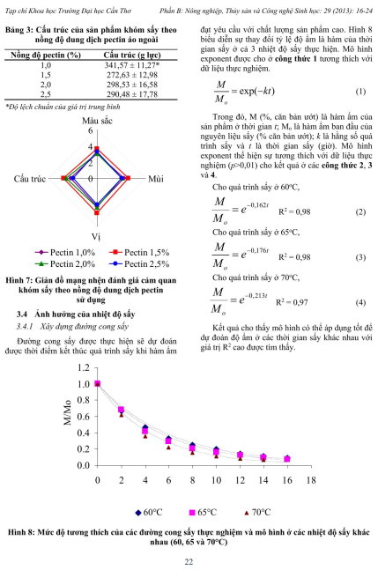
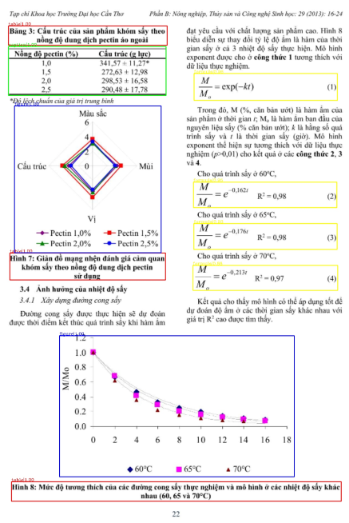

Introduction
Predict
Load
Model
Input
Output
Notes:
Document object detection can be considered as taking an input document image (like the left figure for example) and then let our model predict bounding boxes that capture the objects in the image such as Figure (blue), caption (red), table (green) and Formula (yellow).

Slide 8
Vietnamese document Image Dataset UIT-DODV
Notes:
Trường

Slide 9
Đây là một bộ dữ liệu tài liệu dạng ảnh tiếng Việt.
Notes:
Trường
Trước đây, các bộ dữ liệu dùng cho bài toán phát hiện đối tượng trên tài liệu dạng ảnh thường sử dụng các ngôn ngữ phổ biến trên TG như tiếng anh or tiếng Trung
Điểm đặc biệt mà bộ dữ liệu UIT-DODV mang lại là các nội dung được thể hiện dưới dạng văn bản tiếng việt.

Slide 10
UIT-DODV [1]:
2,394 ảnh
4 lớp: Figure, Table, Caption, Formula.
Nguồn dữ liệu: ảnh PDF, scan bằng điện thoại hoặc máy scan.
Notes:
Trường
Các thông tin chi tiết về UIT-DODV

Slide 11
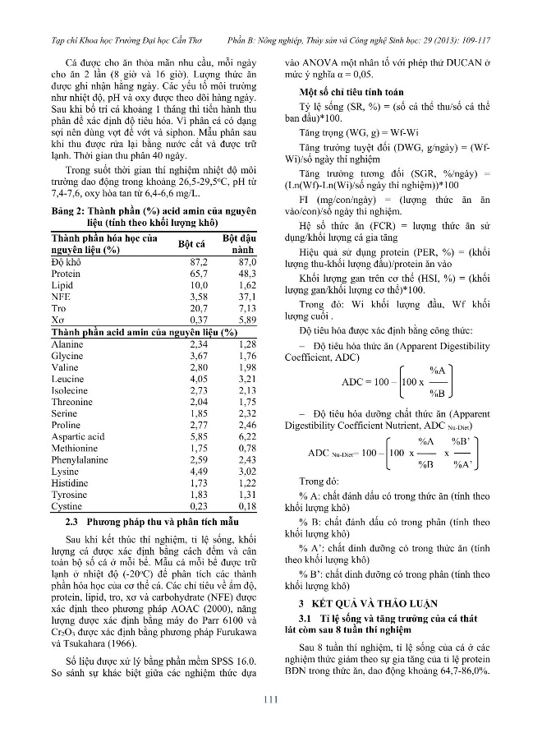
UIT-DODV [1]:
2,394 ảnh
4 lớp: Figure, Table, Caption, Formula.
Nguồn dữ liệu: ảnh PDF, scan bằng điện thoại hoặc máy scan.
Notes:
Trường

Slide 12
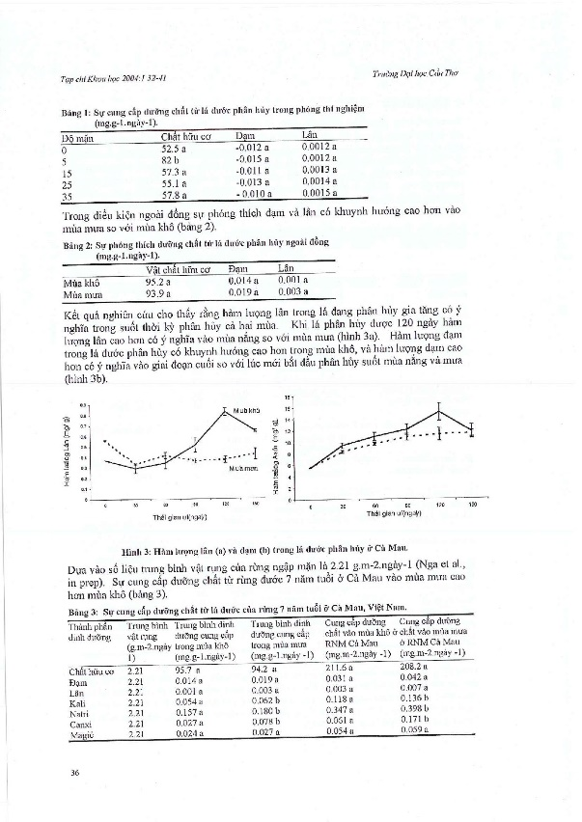
UIT-DODV [1]:
2,394 ảnh
4 lớp: Figure, Table, Caption, Formula.
Nguồn dữ liệu: ảnh PDF, scan bằng điện thoại hoặc máy scan.
Notes:
Trường
Ví dụ minh họa

Slide 13
UIT-DODV
Notes:
Trường
With total 2394 images in UIT-DODV, it’s divided into 3 set
With the number of images shown on the screen

Slide 14
Proposed method – Guided Anchoring Cascade R-CNN

Slide 15
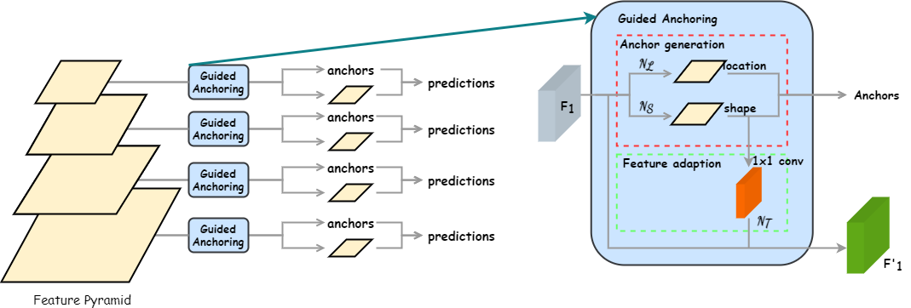
Guided Anchoring
Notes:
In Guided Anchoring totally removed old anchor generations with fixed parameter. Now, our anchors can be generated more flexibly for oversized object or some harsh scenarios.
It’s well-known for its impressive anchor generation and its ability to apply on several anchor-based baseline.
After all, what can we truly obtain here? High-quality anchor boxes.

Slide 16
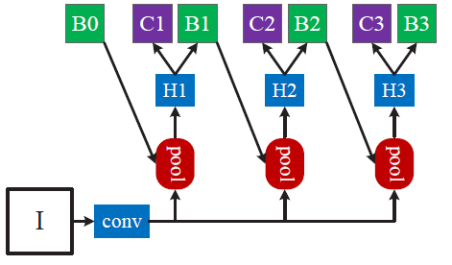
Cascade R-CNN [2]
Notes:
1. In this architecture, we can call it a multi-stage network. In Cascade R-CNN, it is divided into 3 stages with IoU threshold is increased stage by stage
2. This principle will handle confused boxes which didn’t capture the object we need. So, we got a better training process.

Slide 17
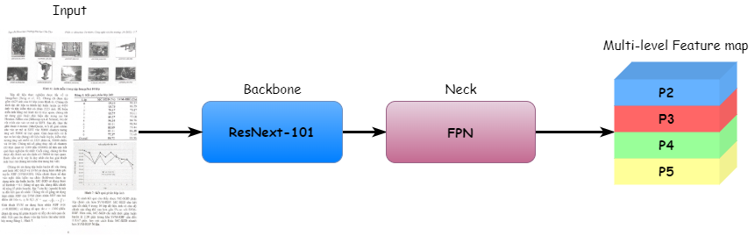
Approach
Notes:
Trường
Moving to our approaching
Ảnh đầu vào sẽ là một tài liệu dạng ảnh tiếng Việt
First, we take a document image as the input and then extract feature with ResNext-101 as our backbone.
Tiếp đến tiến hành dùng kiến trúc mạng FPN để tạo ra các đặc trưng đa tầng
Then, we use FPN to integrate multi-level feature because we know how valuable is the information that FPN can bring us

Slide 18
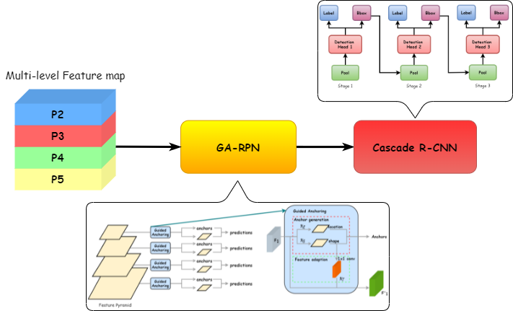
Approach
Notes:
Trường
Now, it’s time for Guided Anchoring to generate excellent anchor-boxes that will capture probably where the object is.
Và nghiên cứu của module GA đã chỉ ra rằng đặc trưng từ tầng 2 đến tầng 5 mang lại hiệu suất tốt nhất cho mô hình, có thể sử dụng nhiều đặc trưng hơn nhưng kết quả mang lại không cao va tốn kém chi phí đáng kể.
Sau đó khi thực hiện xong ở giai đoạn GA-RPN sẽ thu được các anhor và feature map và tiến hành giai đoạn training với mạng cascade rcnn
Finally, we fed all of them into Cascade R-CNN and wait for the output

Slide 19
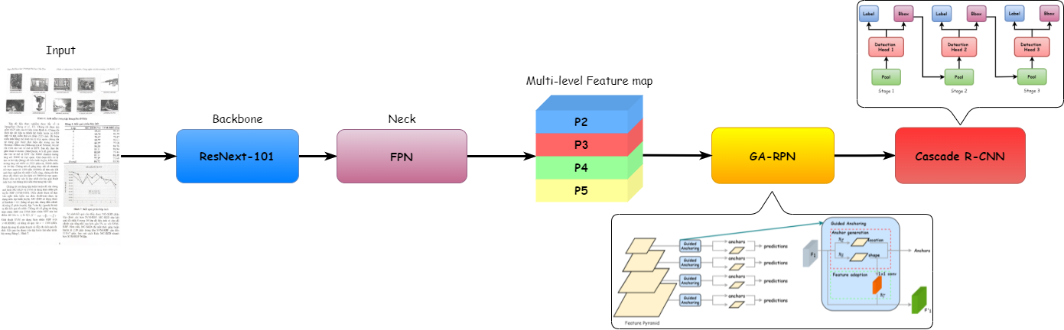
Guided Anchoring Cascade R-CNN
Notes:
Trường
Dưới đây là flow cơ bản cho quá trình thực nghiệm của nhóm chúng em
Có thể các bạn đã biết, Điều tiên quyết để có được một mô hình anchor base có độ chính xác cao thì cần phải cải thiện chất lượng các anchor box
Nhờ vào các anchor chất lượng tốt đến từ quá trình khởi tạo của Guided Anchoring kết hợp với khả năng lọc bounding box không cần thiết từ việc tác động lên ngưỡng IoU lên từng tầng như đã đề cập trước đó.

Slide 20
Experiments
Notes:
Trường

Slide 21
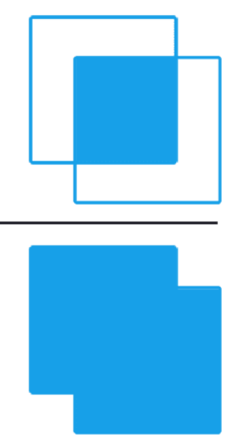

Metrics
Intersection over Union (IoU):
$$IoU=\frac{Area of Overlap}{Area of Union}$$
Notes:
Trường
Giả sử chúng ta sẽ có ground-truth bounding box và predicted bouding box
IoU càng cao cho ra kết quả càng tốt

Slide 22

Metrics
Mean Average Precision (mAP) – MS COCO [3]:
Intersection over Union (IoU):
$$IoU=\frac{Area of Overlap}{Area of Union}$$
$$mAP@α=\frac{1}{n}\sum_{i=1}^{n}{{AP}_{i}} for n classes$$
Notes:
Trường
Để có thể đánh giá mô hình một cách khách quan thì nhóm chúng em sử dụng độ đo mAP để có thể so sánh với các phương pháp đã được thực hiện trên baseline của UIT-DODV trước đó.
So sánh kết quả trên baseline UIT-DODV

Slide 23

Metrics
Mean Average Precision (mAP) – MS COCO [3]:
AP@.5: AP at IoU = .50
AP@.75: AP at IoU = .75
mAP: AP at IoU = .50:.05:.95
Intersection over Union (IoU):
$$IoU=\frac{Area of Overlap}{Area of Union}$$
$$mAP@α=\frac{1}{n}\sum_{i=1}^{n}{{AP}_{i}} for n classes$$
Notes:
Trường
Biến thể của độ đo AP
For the primary AP, 0.5:0.05:0.95 means starting from IoU = 0.5, with steps of 0.05, we increase to an IoU = 0.95

Slide 24
Experimental results on UIT-DODV dataset (%)
Method | Table | Figure | Caption | Formula | AP@.5 | AP@.75 | mAP
Double-Head Faster R-CNN | 91.5 | 80.6 | 65.6 | 46.3 | 88.7 | 78.4 | 71.0
Libra Faster R-CNN | 92.5 | 81.0 | 68.2 | 46.0 | 89.6 | 79.1 | 71.9
Guided Anchoring Faster R-CNN | 92.7 | 81.6 | 73.3 | 46.9 | 91.0 | 80.8 | 73.6
Notes:
We make an efficiency comparison between three methods, Double Head R-CNN, Libra R-CNN and Guided Anchoring.
Guided Anchoring proves to be the best performance in our results.
It improves Caption detection dramatically, Guided Anchoring reach 73.3%, This is a large distance as it got 5.1% higher than the second highest result.
In addition, GA reach 73.6% in terms of mAP, 1.7% higher than Libra R-CNN and 2.6% higher than DoubleHead R-CNN.

Slide 25
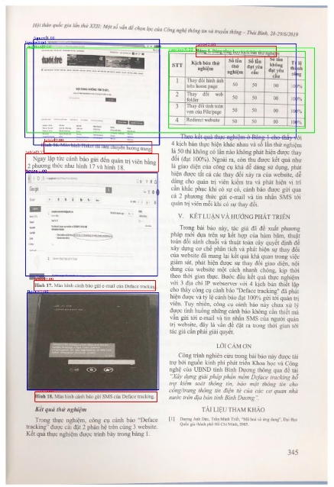
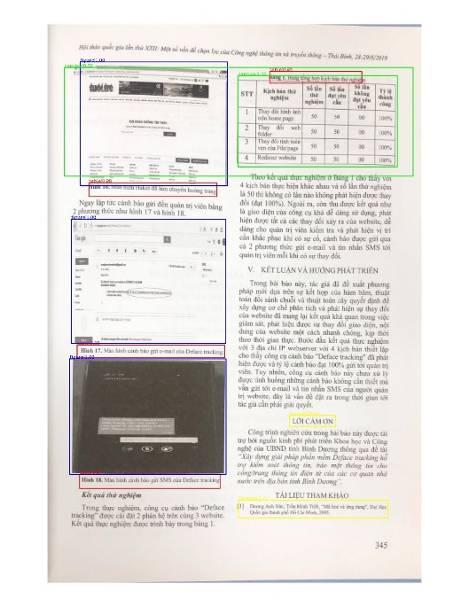
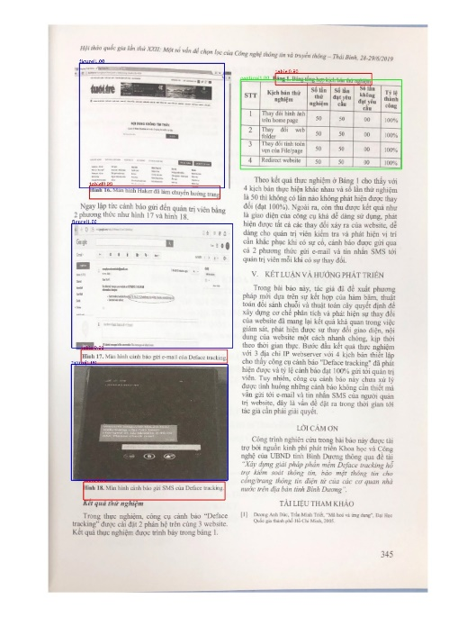
Visualization
Double-Head R-CNN
Libra R-CNN
Guided Anchoring

Slide 26
Visualization
Overlap
Wrong prediction
Double-Head R-CNN
Libra R-CNN
Guided Anchoring
Notes:
All of them were doing pretty well but there were overlaps as you can observe from the visualization of Double Head R-CNN and Libra R-CNN.
Moreover, there is misunderstanding between background and formula in visualization of Libra R-CNN.
So, what about Guided Anchoring?
Although its predictions is not too excellent but
No overlaps and no wrong predictions. Perfect

Slide 27
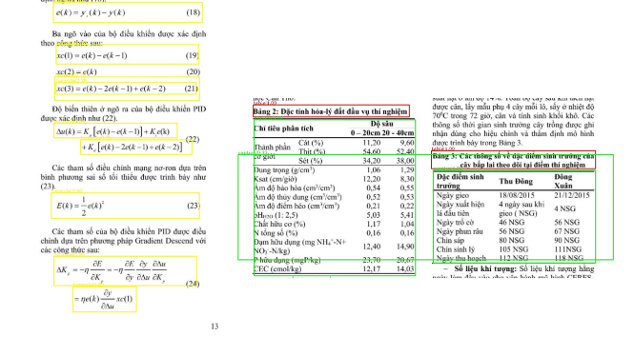
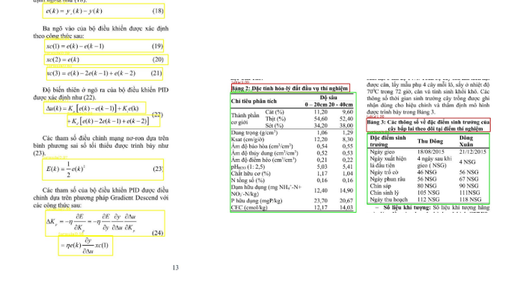
Visualization
Faster R-CNN
Cascade R-CNN
Notes:
Trường
Ban đầu phân vân cascade rcnn có tốt hơn faster rcnn kh?
Về Tổng quan thì kết quả thu đc faster rcnn và cascade đề u tốt

Slide 28
Visualization
Overlap
Faster R-CNN
Cascade R-CNN
Notes:
Trường
there are still overlaps in Faster R-CNN while Cascade R-CNN is doing its task perfectly.
This may be because of the principle of Cascade R-CNN, it increases IoU threshold on each stage so that we can filter out most confusing bounding boxes.
Faster R-CNN phát hiện được hiểu quả của mình khi kết quả nhận được là những dự đoán rất chính xác các đối tượng. Tuy nhiên, tình trạng overlap xuất hiện khi hai bảng được đặt gần nhau, tương tự với đối tượng “Công thức” cũng vậy.
kiến trúc phân tầng của phương pháp Cascade R-CNN đã giải quyết rất hiệu quả vấn đề xảy ra khi tăng ngưỡng IoU. => Chọn cascade rcnn

Slide 29
Comparison between proposed method and state-of-the-art models on UIT-DODV (%)
Method | Table | Figure | Caption | Formula | AP@.5 | AP@.75 | mAP
Double-Head Faster R-CNN | 91.5 | 80.6 | 65.6 | 46.3 | 88.7 | 78.4 | 71.0
Libra Faster R-CNN | 92.5 | 81.0 | 68.2 | 46.0 | 89.6 | 79.1 | 71.9
Guided Anchoring Faster R-CNN | 92.7 | 81.6 | 73.3 | 46.9 | 91.0 | 80.8 | 73.6
CascadeTabNet + Fused Loss [1] | 94.3 | 83.0 | 73.3 | 47.5 | 89.1 | 81.6 | 74.5
Guided Anchoring Cascade R-CNN (Ours) | 95.4 | 84.8 | 75.9 | 50.5 | 91.8 | 83.1 | 76.6
Notes:
Additionally, we experiment on 4 other methods to evaluate our proposed design.
Our model performance incredibly outperform the others as it got the highest mAP in every aspects.
The main contribution that we bring here is we significantly improve the lowest mAP class, that is Formula. Our model got 50.5%, 3% higher than the CascadeTabNet + Fused Loss.
Furthermore, our model improves ‘Caption’ result by 2.6% compared to the second highest mAP.
Besides, our mAP reached 76.6% as the best result during our experiment. Namely, 2.1% higher than the Cascade TabNet.
As well, AP50 AP75 results are increased by 1.7% and 1.5% respectively compared to the previous baseline

Slide 30
References
[1]Parsing Digitized Vietnamese Paper Documents
[2]Cascade R-CNN — Delving into High Quality Object Detection (Object Detection)
[3]Microsoft COCO: Common Objects in Context

Slide 31
Thanks for listening
Authors:
Lê Trương Ngọc Hải – 20520481
Nguyễn Nhật Trường - 20522087

